Slide 1






Will the first stage of a Falcon 9 rocket launch successfully land?
Mohammed Abu Jaafar
Date: 2/13/2023

Slide 2



OUTLINE
Executive Summary
Introduction
Methodology
Results
Visualization – Charts
Dashboard
Discussion
Findings & Implications
Conclusion
Appendix

Slide 3

EXECUTIVE SUMMARY
We will predict whether the SpaceX Falcon 9 first stage will successfully land in this capstone project.
We can calculate the cost of a launch if we know if the first stage will land. This will be accomplished through the application of various machine learning classification algorithms.
Data Collection, Data Wrangling and Preprocessing, Exploratory Data Analysis, Data Visualization, and finally Machine Learning Prediction will be the methodology used
.During our investigation, the results of our analysis show that there are some characteristics of rocket launches that are related to the failure or success of the launch.
Finally, we conclude that the Decision Tree is possibly the best machine learning algorithm for this problem.

Slide 4

INTRODUCTION
The primary goal of this capstone project is to forecast whether the Falcon 9 first stage will successfully land. SpaceX is so proud of its ability to reuse the first stage of a rocket launch that they advertise on their website that their rocket launches cost 62 million while other providers charge up to 165 million. The reusability of the first stage accounts for a large portion of these savings. We can calculate the cost of a launch if we know if the first stage will land. This data can be used if another company wants to compete with SpaceX for a rocket launch.
This takes us to our major question, which is: Will the first stage of a Falcon 9 rocket launch successfully land?

Slide 5

METHODOLOGY
Data was collected in two ways: by requesting information from the SpaceX API and by web scraping launch data from a Wikipedia page. The data was then transformed and cleaned using Python’s Pandas library.
Exploratory data analysis (EDA) was performed on the clean data using visualization tools like Python's matplotlib and seaborn libraries, as well as SQL queries to answer questions. Python's interactive visualization packages were used to answer some analytical questions.
Plotly Dash was used to create interactive data visualizations and Folium was used to create maps.
For the predictive analysis, four different machine learning classification models were used. Logistic regression, support vector machines, k-nearest neighbor, and decision tree classifier were the models used. To find the best model, each one was trained, tuned, and evaluated.

Slide 6
Completed labs : Data wrangling & Data Collection
Data Collection :
Request and parse the SpaceX launch data using the GET request
Normalize JSON response into a dataFame
Extract only useful columns using auxiliary functions
Create new Pandas data Frame from dictionary
Filter data Frame to only include Falcon 9 launches
Handle missing values
Export to CSV file
Data Wrangling :
Calculate the number of launches on each site
Calculate the number and occurrence of each orbit
Calculate the number and occurrence of mission outcome per orbit type
Create a landing outcome label from Outcome column using one-hot encoding
Export to CSV

Slide 7
EDA with Data Visualizations
Visualize the relationship between :
Flight Number and Launch Site- scatter plot
Payload and Launch Site- scatter plot
success rate of each orbit type -bar plot
Click here
Visualize the relationship between :
Flight Number and Orbit type -scatter plot
Payload and Orbit type- scatter plot
launch success yearly trend – line plot

Slide 8
EDA with SQL The following are some of the SQL queries operated on the dataset:
Displaying
Listing
the names of the unique launch sites in the space mission
5 records where launch sites begin with the string 'CCA'
total payload mass carried by boosters launched by NASA (CRS)
average payload mass carried by booster version F9 v1.1
the date when the first successful landing outcome in ground pad was achieved.
names of the boosters which have success in drone ship and have payload mass greater than 4000 but less than 6000
total number of successful and failure mission outcomes
names of the booster_versions which have carried the maximum payload mass.

Slide 9
EDA with SQL(Continued) The following are some of the SQL queries operated on the dataset:
Ranking
Listing
the count of landing outcomes (such as Failure (drone ship) or Success (ground pad)) between the date 2010-06-04 and 2017-03-20, in descending order
Click here
the failed landing_outcomes in drone ship, their booster versions, and launch site names for in year 2015

Slide 10
Launch Sites Locations Analysis with Folium
Marked all launch sites on a map
Marked the success/failed launches for each site on the map
Calculated the distances between a launch site to its proximities
Click here
By combining these objects, the following geographical trends about launch locations are discovered:
Yes, launch sites close proximity to railways
Yes, launch sites in close proximity to highways
Yes, launch sites in close proximity to coastline
Yes, launch sites keep certain distance away from cities

Slide 11
Build a Dashboard with Plotly Dash
The dashboard will shows us :
1- a pie chart displaying each site's successful launch. This graph is helpful since it allows you to see the success rate of launches on specific sites or view the distribution of landing results across all launch locations.
2- a scatter diagram showing the link between landing success and the mass of various boosters.
Click here

Slide 12
Predictive Analysis Methodology
1- Create column for “Class”
2-Standardizing the data
3-Split into training and test set
4- Find best Hyperparameter for SVM, Decision Trees, K-Nearest Neighbors and Logistic Regression.
5-Use test data to evaluate models based on their accuracy scores and confusion matrix
Click here

Slide 13
RESULTS

Slide 14
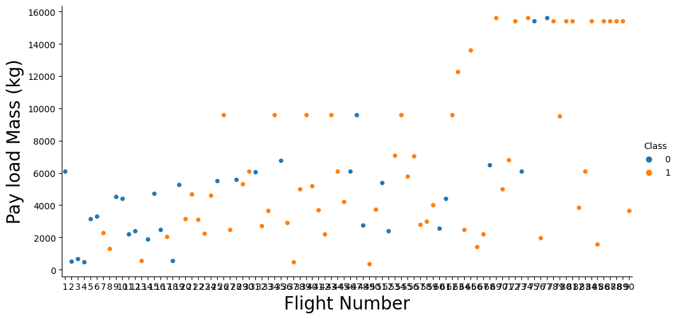
Flight Number vs Pay load Mass(Kg)
flight number increases, the first stage is more likely to land successfully.
more massive the payload, the less likely the first stage will return

Slide 15
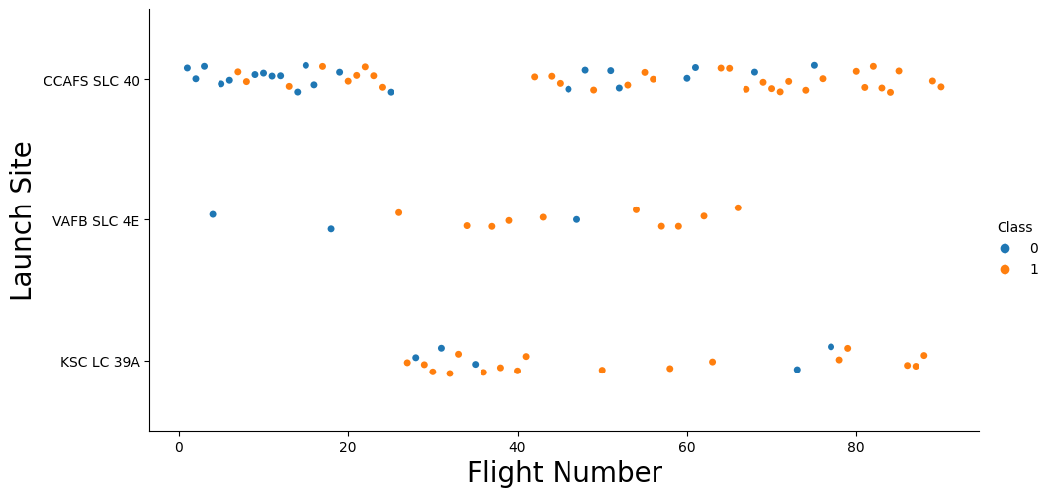
relationship between Flight Number and Launch Site
different launch sites have different success rates.
CCAFS LC-40, has a success rate of 60 %, while KSC LC-39A and VAFB SLC 4E has a success rate of 77%.

Slide 16
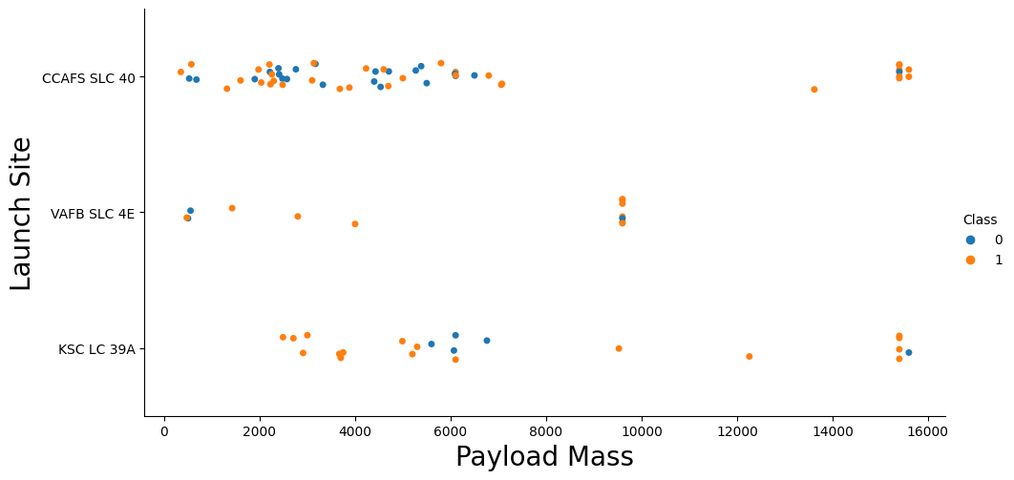
relationship between Payload and Launch Site
the VAFB-SLC launch site there are no rockets launched for heavy payload mass(greater than 10000).

Slide 17
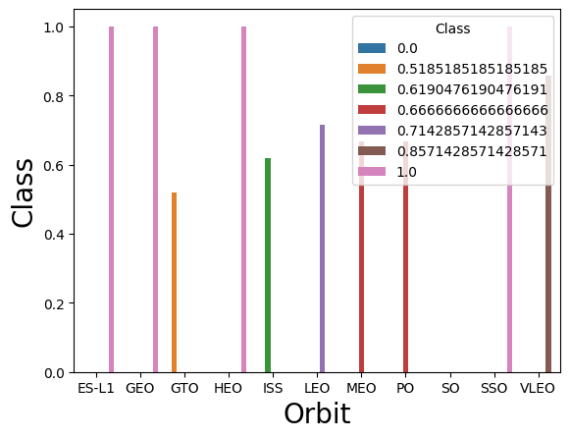
relationship between success rate of each orbit type
Successful Orbits are ES-L1,HEO, SSO,GEO

Slide 18
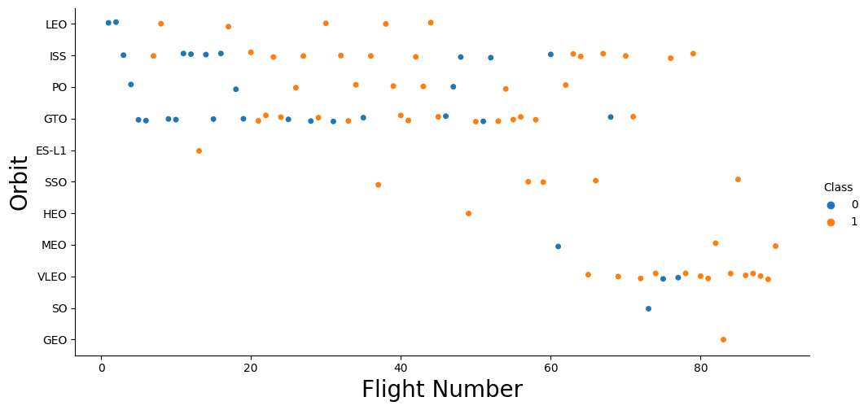
relationship between Flight Number and Orbit type
LEO orbit the Success appears related to the number of flights
seems to be no relationship between flight number when in GTO orbit.

Slide 19
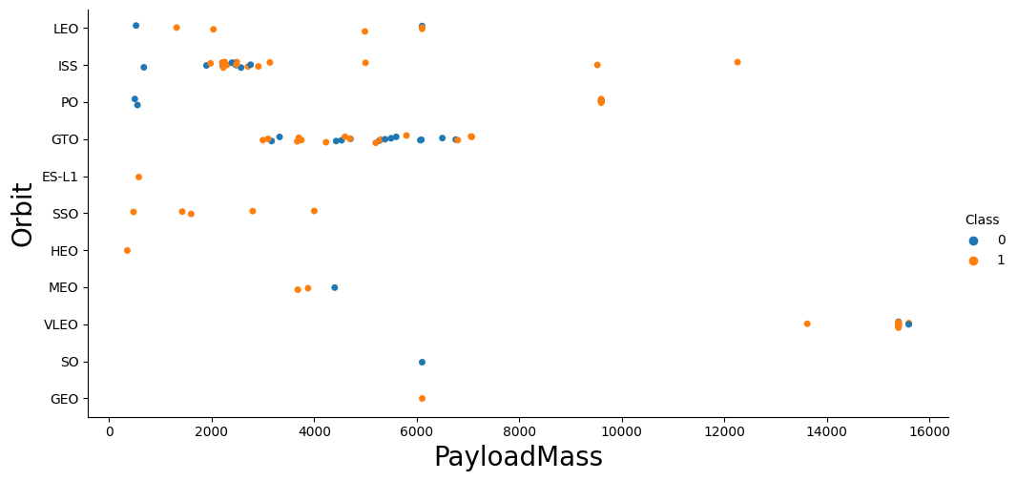
relationship between Payload and Orbit type
With heavy payloads the successful landing or positive landing rate are more for Polar,LEO and ISS
Notes:
GTO we cannot distinguish this well as both positive landing rate and negative landing(unsuccessful mission) are both there here.

Slide 20
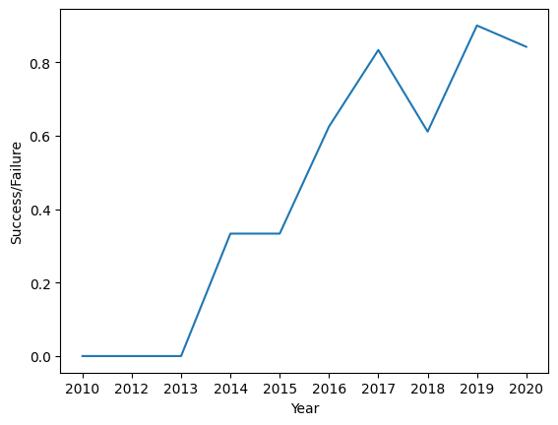
launch success yearly trend
success rate since 2013 kept increasing till 2020

Slide 21
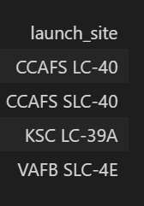
Results – EDA with SQL : displaying
1-unique launch sites in the space mission

Slide 22
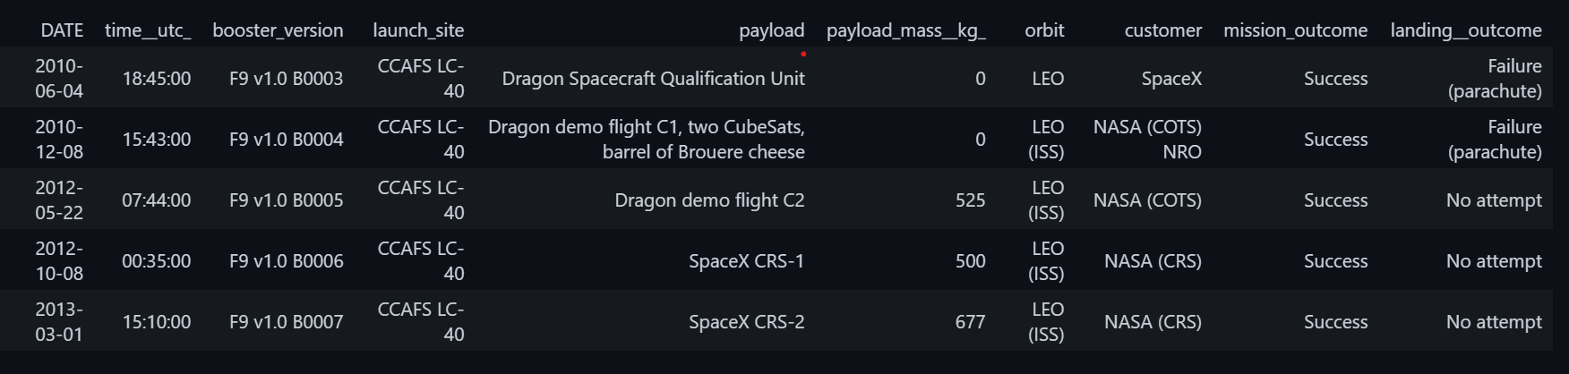
Results – EDA with SQL : displaying
2- 5 records where launch sites begin with the string 'CCA'

Slide 23
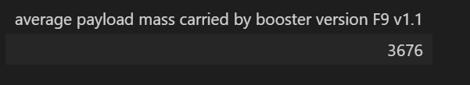
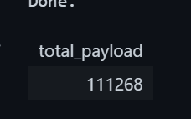
Results – EDA with SQL : displaying
3- total payload mass carried by boosters launched by NASA (CRS)
4- average payload mass carried by booster version F9 v1.1

Slide 24

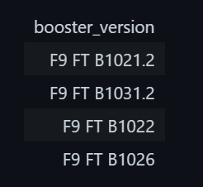
Results – EDA with SQL : listing
5-date when the first successful landing outcome in ground pad was achieved
6- the boosters which have success in drone ship and have payload mass greater than 4000 but less than 6000

Slide 25
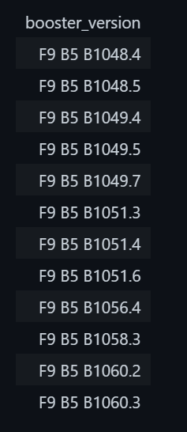
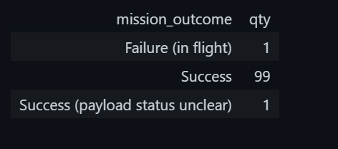
Results – EDA with SQL : listing
8- names of the booster_versions which have carried the maximum payload mass
7- total number of successful and failure mission outcomes

Slide 26
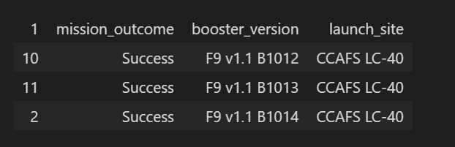
Results – EDA with SQL : listing
9- failed landing_outcomes in drone ship, their booster versions, and launch site names for in year 2015

Slide 27
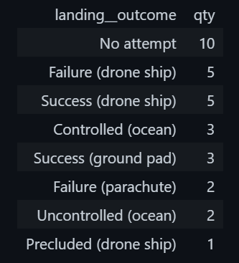
Results – EDA with SQL : Ranking
10- count of landing outcomes (such as Failure (drone ship) or Success
between the date 2010-06-04 and 2017-03-20, in descending order

Slide 28
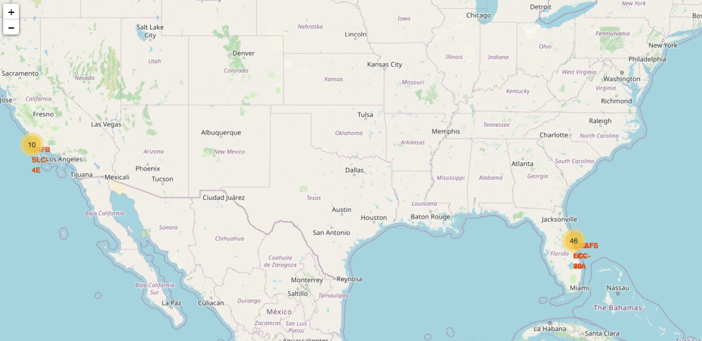
SpaceX Launch Sites Locations
The locations of all the SpaceX launch sites in the US are shown by the yellow markers.
The launch locations have been situated strategically along the coast.

Slide 29
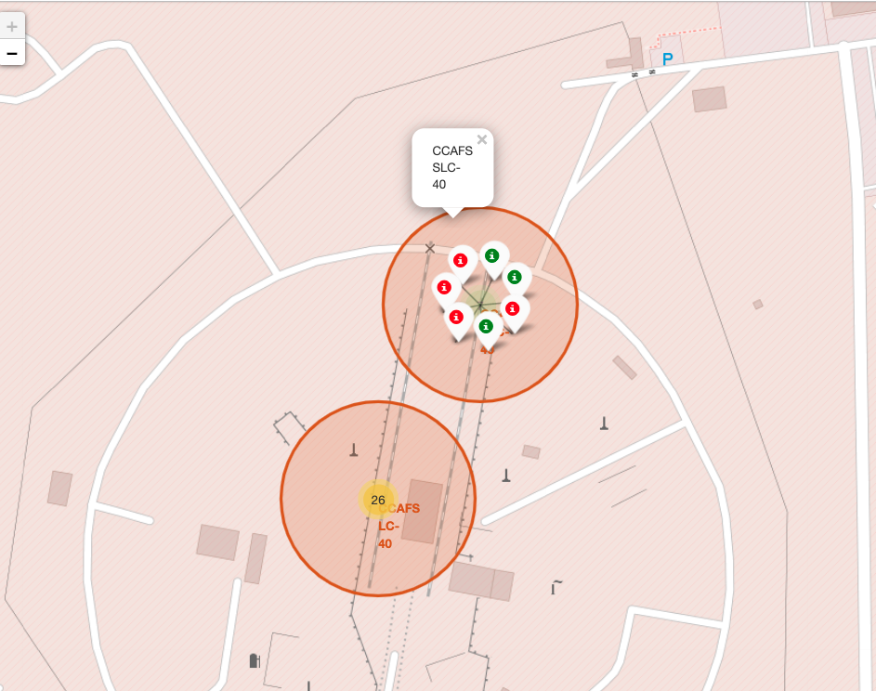
Does it succeed or fails?
The launch site show marker clusters of successful landings (green) or failed landings as we zoom in on a launch location (red).

Slide 30
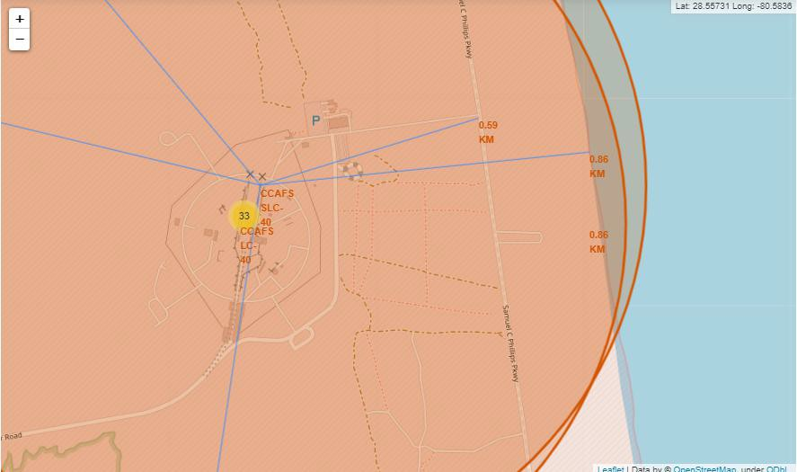
Launch Site Distances
The produced map reveals that the chosen launch point is near to a highway for people and equipment transportation. For launch failure testing, the launch location is also near to the coast.

Slide 31

DASHBOARD
Dashboard with Plotly Dash

Slide 32
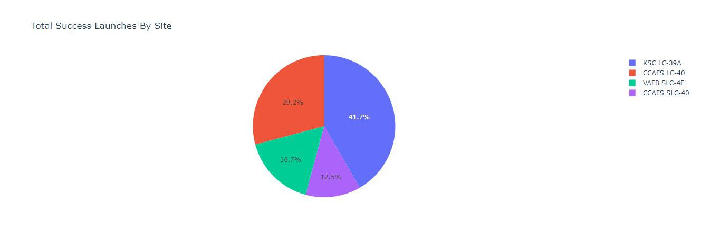
Total Successful Launches By Site
The KSC LC-39A Launch site has the most successful launches with 10 in total.

Slide 33
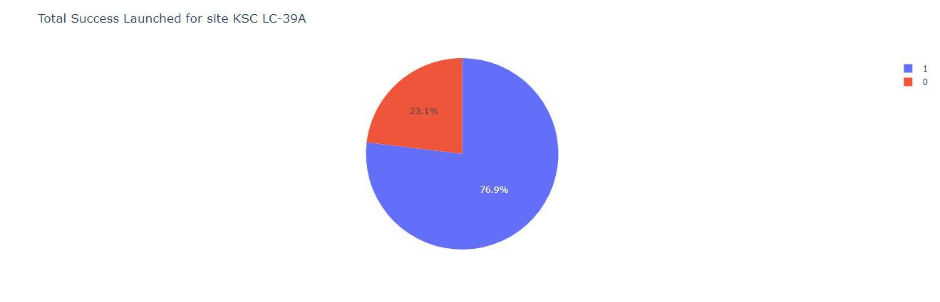
Launch Site With Highest Success Ratio
The KSLC-39A has the highest success rate with 76.9%.

Slide 34
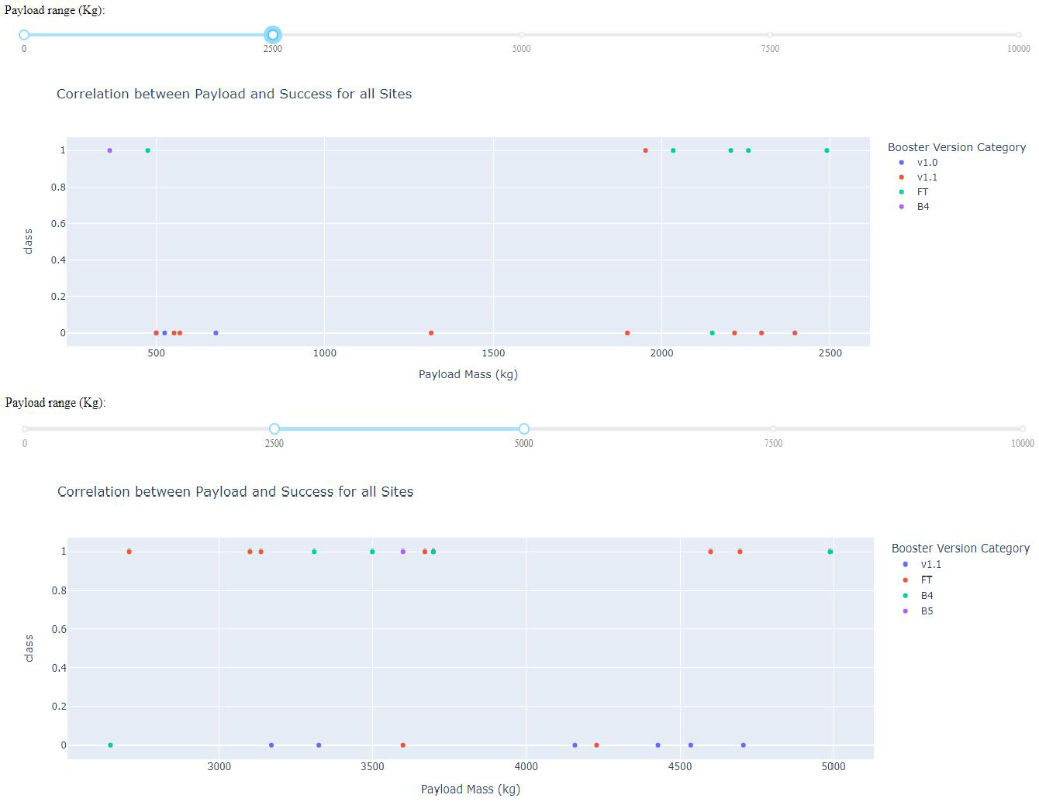
Payloads vs Launch Outcome
The v1.1 booster offers the highest percentage of effectiveness across both weight ranges.
Payloads between 0 and 2500 kg have a somewhat lower launch success percentage than payloads between 250 and 5000 kg. Actually, there isn't much of a distinction between the two.

Slide 35
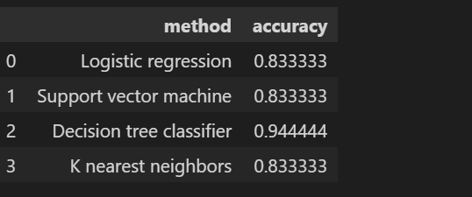
Classification Accuracy
The Decision Tree classifier had the best accuracy at 94%.

Slide 36
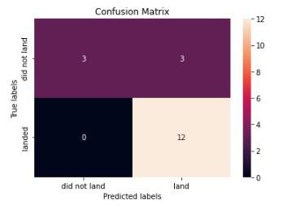
Confusion Matrix
When the True label was success (True Positive), the model predicted 12 successful landings, and when it was failure, it predicted 3 unsuccessful landings (True Negative).
When the True label was an unsuccessful landing, the algorithm also predicted three successful landings (False Positive).
Successful landings were frequently anticipated by the model.

Slide 37

Conclusions
The study revealed that as the success rate has increased over time, there is a positive link between the number of flights and success rate.
The most successful launches occurred in orbits like SSO, HEO, GEO, and ES-L1.
Payload mass can be related to success rate since lighter payloads have often had better results than bigger payloads.
The launch sites are strategically located near highways and railways for transportation of personel and cargo, but also far away from cities for safety.
The Decision Tree Classifier is the most accurate prediction model for this dataset, with a 94% accuracy rate.

Slide 38

Appendix
For all files you can enter the GitHub Repository
GitHub Repository: https://github.com/abujafam/ibm-data-science/tree/main/Final%20project

